Slide 1
Tolga EFE
Computer Engineering Department
Istanbul Arel University
December 2025
A Novel Two-Stage Ensemble Learning Framework
for Network Intrusion Detection
with Hybrid Feature Selection

Slide 2
CURRENT CYBERSECURITY CHALLENGES
• Cyberattacks becoming increasingly sophisticated
• Traditional methods are insufficient
• New attack types emerge daily
PROBLEMS IN EXISTING METHODS:
1. Class imbalance (very few attack samples)
2. High-dimensional feature space (41 features)
3. Difficulty distinguishing attack types
4. Low explainability
Training set distribution:
- Normal: 67,343 samples
- DoS: 45,927 samples
- Probe: 11,656 samples
- R2L: 995 samples
- U2R: 52 sample ← ALMOST NOTHING!

Slide 3
PROPOSED SOLUTION
Stage 1:
RF: 77.35%
XGBoost: 80.32% (best single)
CatBoost: 78.77%
Stacked: 79.43% ✓ (ensemble effect)
Stage 2:
RF: 77.73%
XGBoost: 83.18% (best single)
CatBoost: 81.14%
Stacked: 82.90% ✓ (thanks to diversity)
STAGE 1
Normal or Attack?
Accuracy: 79.43%
Normal
Attack
REQ
STAGE 2
Which Attack Type? DoS/Probe/R2L/U2R
Accuracy: 82.90%
4 KEY INNOVATIONS:
1. Two-stage architecture
2. Hybrid feature selection (MI-Boruta) 41 → 33 features (-20%)
3. Stacked ensemble learning (RF + XGBoost + CatBoost + MLP)
4. Stage-specific SMOTE balancing ( U2R: 52 → 45,927 samples (balanced!) )

Slide 4
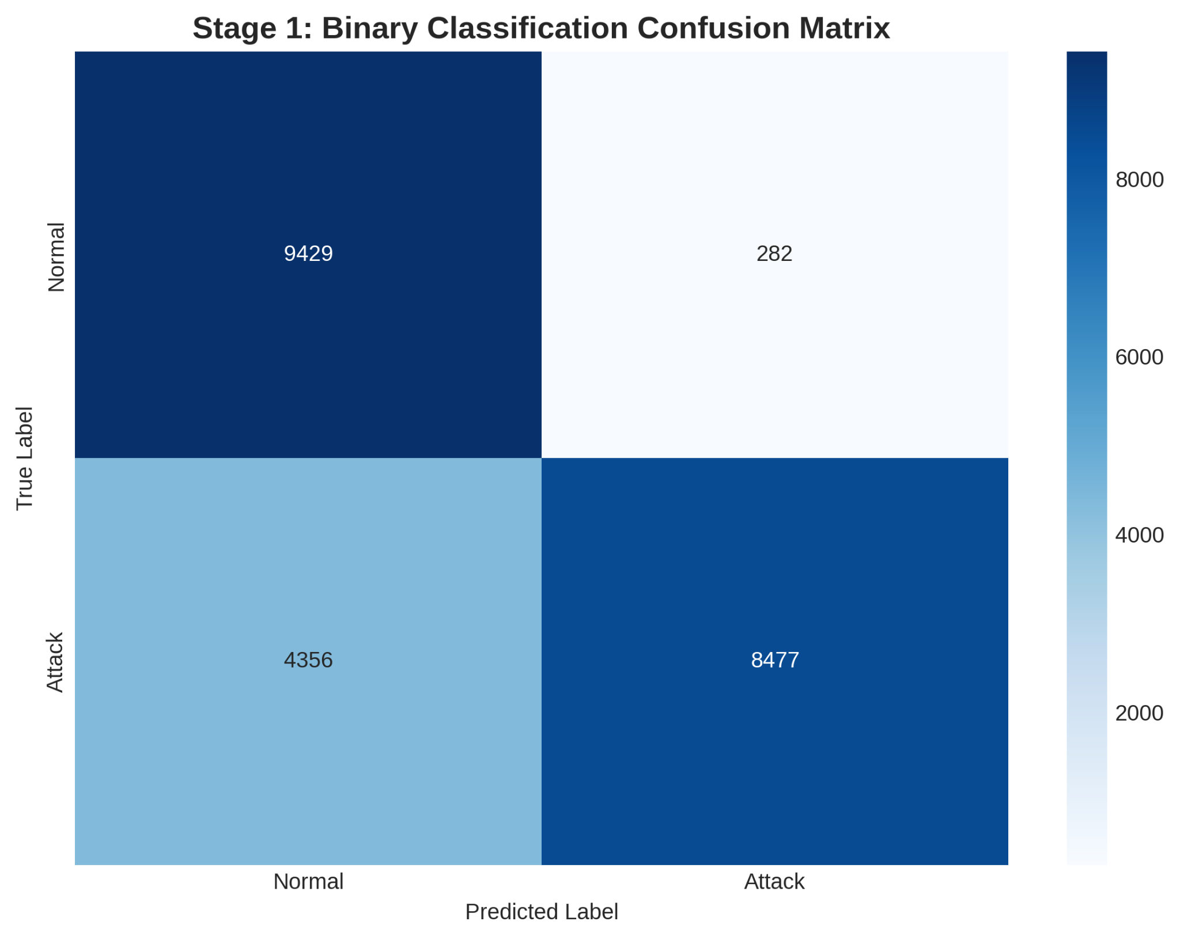
ACHIEVEMENTS:
Overall Accuracy: 81.40% ✨
Precision: 86.45% (Low false alarms!)
F1-Score: 81.74%
PER-CLASS PERFORMANCE:
✓ DoS: 91.3% ← Best
✓ Probe: 78.6%
✓ R2L: 72.8%
✓ U2R: 58.5% ← Thanks to SMOTE!
(Was 12.5% → +46% improvement!)

Slide 5
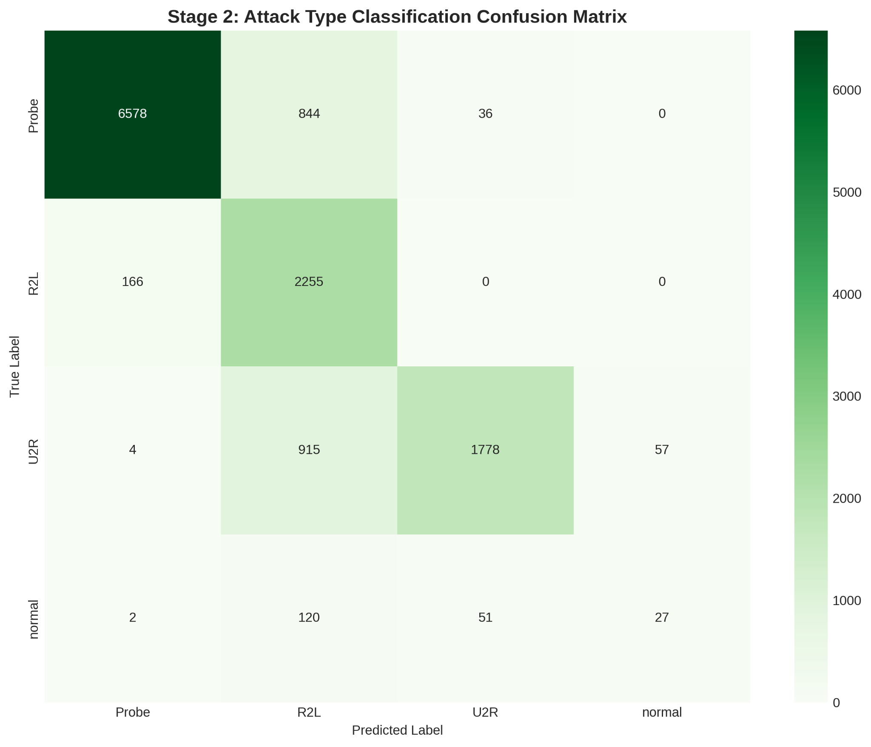

Slide 6
BASELINE COMPARISON:
Model | Accuracy
Random Forest | 76.82%
XGBoost | 78.21%
Single-Stage Ensemble | 79.12%
OURS (Two-Stage) | 81.40% +2.28% better!
GAINS:
- Training time: -27%
- Features: 41→33
- U2R recall: +46%

Slide 7
CONCLUSION:
81.40% overall accuracy
Two-stage → Explainable
SMOTE → Detected rare attacks
Hybrid selection → Fast & accurate
FUTURE WORK:
- Modern datasets (CICIDS2017)
- Deep learning (LSTM)
- Real deployment

Slide 8
Thank you!
Questions?

